Slide 1
Real-time Air Quality Index Data Analytics
📊 Dataset Analysis & Visualization using PySpark
D. Sathvik
2211CS010141
Mail id: dsathvik204@gmail.com

Slide 2
Dataset Information
- Dataset Source: [Mention your dataset source or portal]
- Number of Records: ~[fill in after cleaning]
- Columns:
• City → Name of the city where AQI is recorded
• Pollutant → Type of pollutant measured (PM2.5, PM10, NO2, CO, O3, SO2)
• Pollutant_avg → Average concentration values
• Date → Timestamp of measurement
- Objective: To analyze air quality patterns and pollutant behavior across cities.

Slide 3
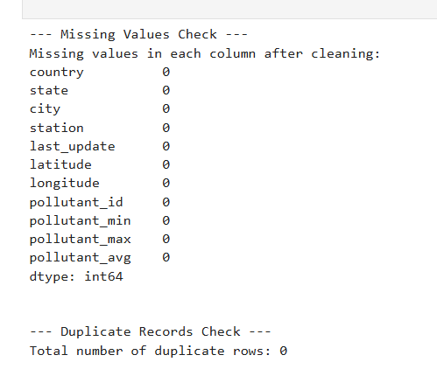
Initial Analysis
- Checked for missing and invalid values (e.g., 'NA')
- Replaced/removed nulls and converted columns to numeric types
- Dataset cleaned and ready for visualization

Slide 4
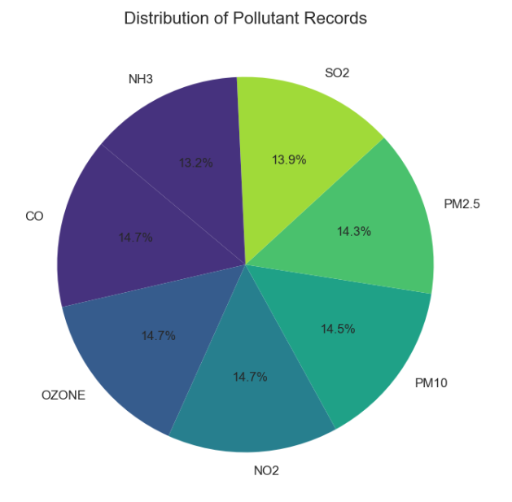
Distribution of Pollutant Records
Explanation:
A pie chart was created to show the proportion of different pollutants recorded in the dataset.
The chart uses percentage values to represent the share of each pollutant.
Insights:
The dataset contains multiple pollutants, each contributing a different proportion to the overall records.
Some pollutants (like PM2.5 or PM10) may dominate the dataset, highlighting their frequent monitoring.
Less frequent pollutants (like SO2 or O3) still provide important insights into air quality.
This helps identify which pollutants are most commonly tracked and potentially most concerning.

Slide 5
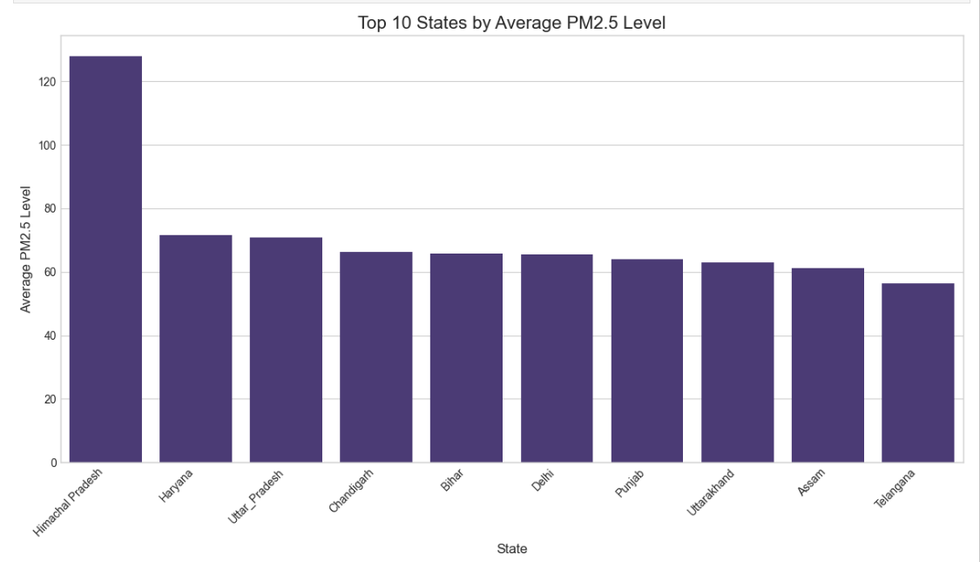
Top Polluted Cities
- Bar Plot / Ranking Table
- Explanation: Cities with highest average pollutant concentrations.
- Insights:
• Identifies pollution hotspots.
• Useful for policymaking and awareness campaigns.

Slide 6
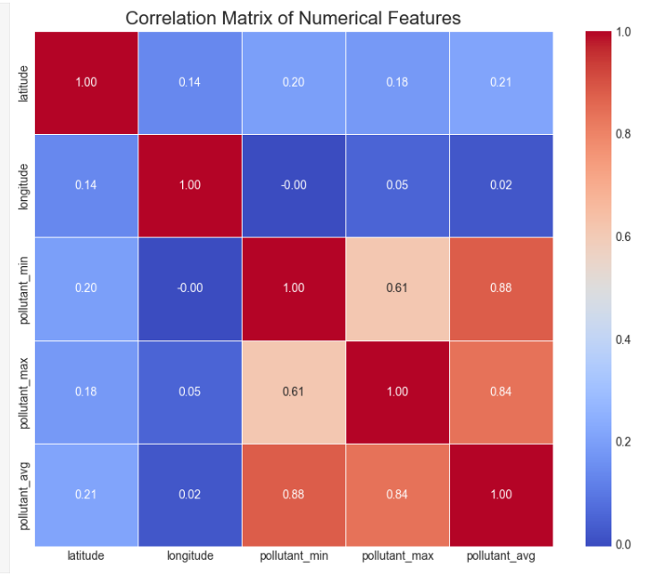
Correlation Heatmap
- Explanation: Displays correlation between pollutant levels.
- Insights:
• Strong correlation observed between PM2.5 & PM10.
• Weak correlation between gases (CO, O3, SO2) and particulate matter.

Slide 7
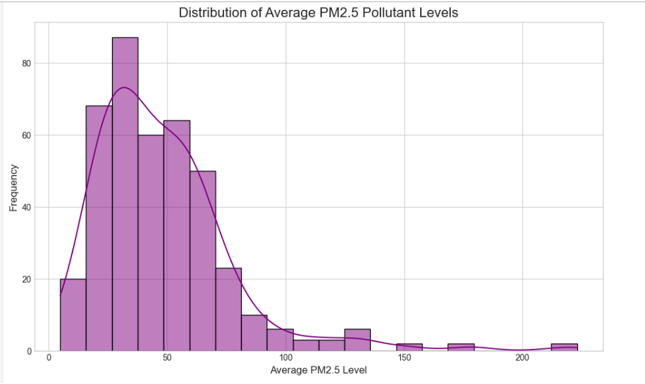
Distribution of Pollutant Levels
- Histogram
- Explanation: Shows how pollutant values are spread across cities.
- Insights:
• Some pollutants show normal distribution, while others are skewed.
• Certain cities face consistently higher pollutant averages.

Slide 8
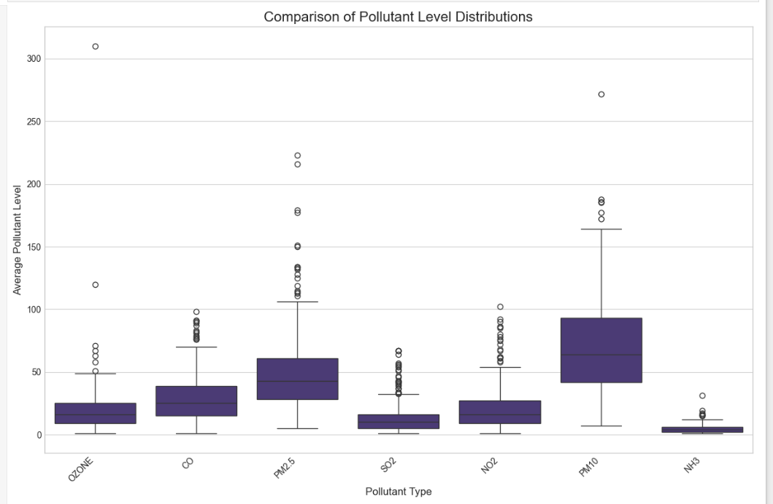
Box Plot of Pollutants
- Explanation: Spread of pollutants with medians and outliers.
- Insights:
• PM2.5 and PM10 have high variability.
• Outliers indicate extreme pollution days.

Slide 9
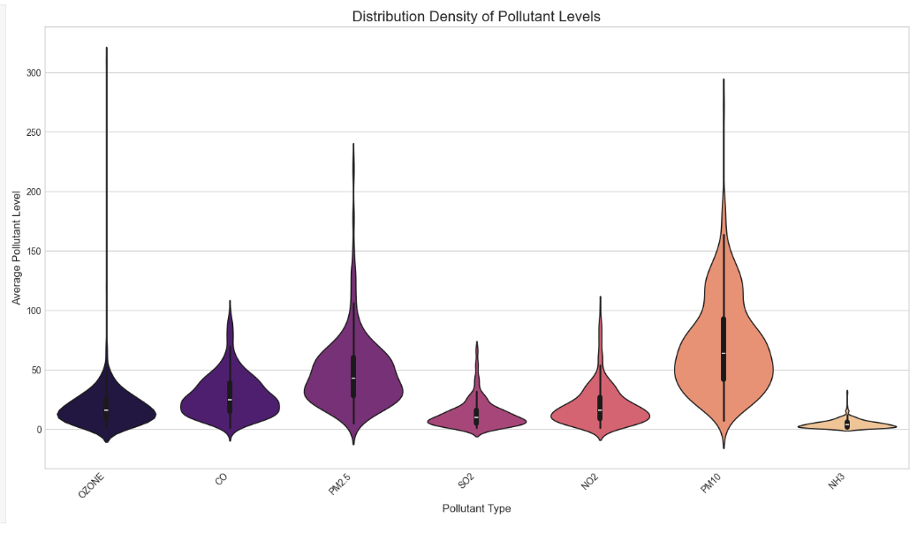
Distribution Density of Pollutant Levels (Violin Plot)
Explanation:
A violin plot was used to visualize the distribution and density of pollutant levels for each pollutant type.
The plot combines features of a box plot with a kernel density estimate, showing both the spread and concentration of values.
Insights:
Pollutant levels vary significantly depending on the pollutant type.
Wider sections of the violins indicate ranges where pollutant values are more concentrated.

Slide 10
Conclusion
- Dataset cleaned and processed successfully.
- Strong correlation between particulate pollutants.
- Metro cities face higher pollution burden.
- Seasonal and temporal patterns are significant.
- Insights can support environmental monitoring & policymaking.

